Slide 1
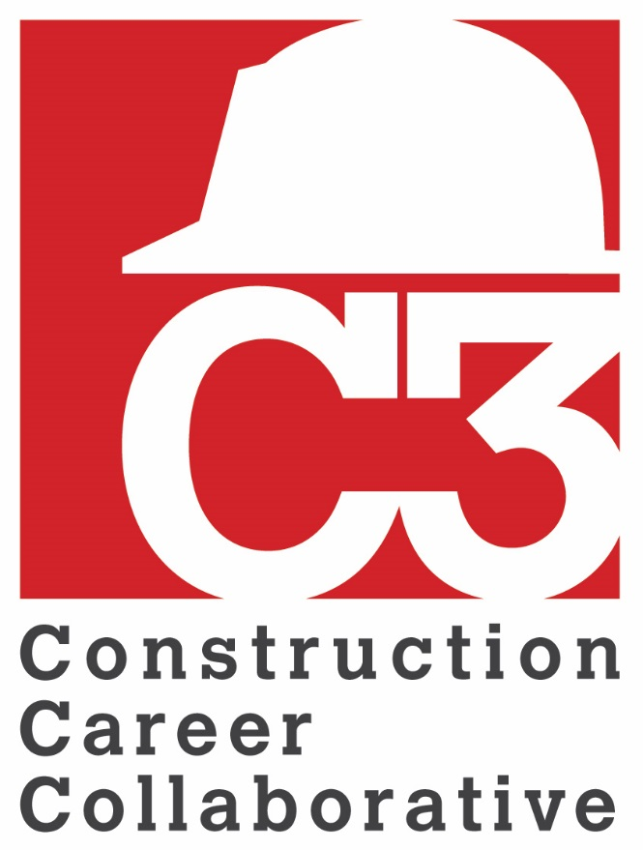
Orientation for
Craft Professionals
Notes:
Welcome to C3 Orientation for Craft Professionals!

Slide 2
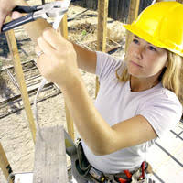
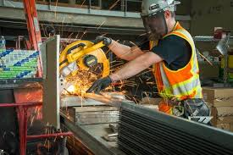
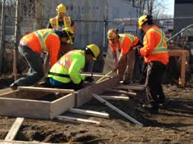
What is C3?
C3 is a non-profit organization… working to create a safe, skilled and sustainable craft workforce.
Notes:
WHY C3
C3 is a non-profit organization of building owners, general contractors and specialty contractors (both merit shop and union shop), as well as architects and industry trade organizations that are working together to establish a safe, skilled and sustainable craft workforce. This goal is achieved with a focus on three key elements, hiring craft workers as hourly employees, providing safety training and craft skills training linked to construction career paths.

Slide 3
What does that mean to me?
A CAREER not just a job!
Hourly pay - with overtime
No piece work!
You are an employee not an independent subcontractor.
OSHA 10 safety training for craft workers
OSHA 30 safety training for supervisors
on-going safety-refresher training
Workers Compensation Insurance Coverage
Skills training
linked to your construction career path
Notes:
You may wonder how this affects you, the craft professional? If your employer is a C3 Accredited Employer or a C3 Project Participant:
It has committed to pay you as an hourly employee with overtime pay when you work more that 40 hours in a seven-day pay period.
Your employer has committed to provide safety training that includes OSHA 10 for craft workers and OSHA 30 for supervisors.
Your employer has committed to provide workers compensation insurance coverage to protect you in the event of an on-the-job injury.
Very importantly, if your employer is a C3 Accredited Employer, it has also committed to provide craft skills training linked to competencies identified in a construction career path that has been developed for you.
All of this enables you to work safely and earn more money while moving up the career ladder as your skills grow. Be sure to ask your employer about its craft training program and the career path that applies to you.

Slide 4
Compliance Checks
Verification of OSHA safety training
Jobsite interviews
Confirmation of employment status
Hourly pay and overtime when earned
Payroll taxes are deducted and matched
Employee not an independent subcontractor
Notes:
To protect the integrity of the C3 program, C3 conducts periodic compliance visits to C3 Projects, such as the one you are starting today. During our visit, the C3 Compliance Manager will verify that
Each worker has the proper OSHA safety credentials.
That you are an employee and not and independent subcontractor, which means that you are paid by the hour, not by the piece, and you earn overtime pay when you work more than 40 hours in a seven-day pay period.
And finally, that state and federal employment taxes are deducted from your pay and matched as required by law.
So if you are greeted by a C3 Compliance Manager, don’t be concerned, they are working on your behalf.

Slide 5
What can I do?
Inquire about your employer's involvement with C3.
Are they a C3 Accredited Employer?
Have they earned a C3 Craft Training Endorsement?
Ask them to explain their craft training program and how it impacts your career path?
Notes:
Ask your employer about their involvement with C3.
If your employer is a C3 Accredited Employer, have they earned an endorsement from C3 for their craft training program?
If so, ask them to explain their craft training program and how it impacts your career path
If they have not earned a craft training endorsement from C3, tell them that you believe it is important to you and your fellow craft professionals that they do so because it benefits the company too.

Slide 6
With C3, everyone wins!
For the craft professional
Work safely, produce high quality work creating demand for your services
Wage growth
Career path
For the construction company
More productivity, less rework
Greater profitability
Sustainable craft workforce
For the end user of the building
High building performance
Lower maintenance costs
Longer building life cycle
Sustainable craft workforce
The Craft Professional
The Building Occupants
The Construction Company
www.c3.org
Notes:
C3 is a win, win, win for all parties involved in the construction process.
As a craft professional, you benefit from training that enables you to work safely and skillfully thereby creating demand for your services, which grows your wages. The C3 model also establishes career paths for craft professionals. C3 creates careers not just a job!
Construction companies that employ craft professionals benefit from a safe, skilled craft workforce that produces high quality work, with less rework, which creates demand for those companies’ services, improves their profitability and enables them to grow their organizations.
The building owner reaps the benefit of high performing buildings that have lower maintenance costs, fewer warranty calls and longer building lifecycles.
Very importantly, all of this added together generates a sustainable craft workforce!
If you’d like to know more about C3, visit us at www.c3.org.

